Slide 1
SCOTS Conference 9th / 10th May 2024
WSP UK Ltd.

Slide 2
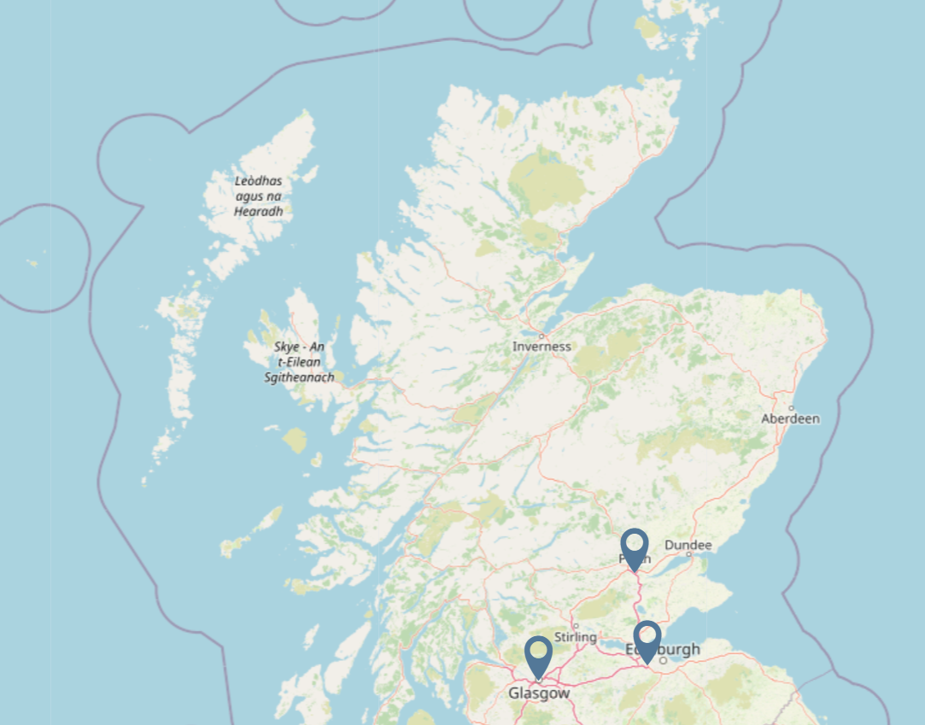
UK Office Locations
Over 9400 staff in over 30 offices including 500+ staff located in Scotland

Slide 3
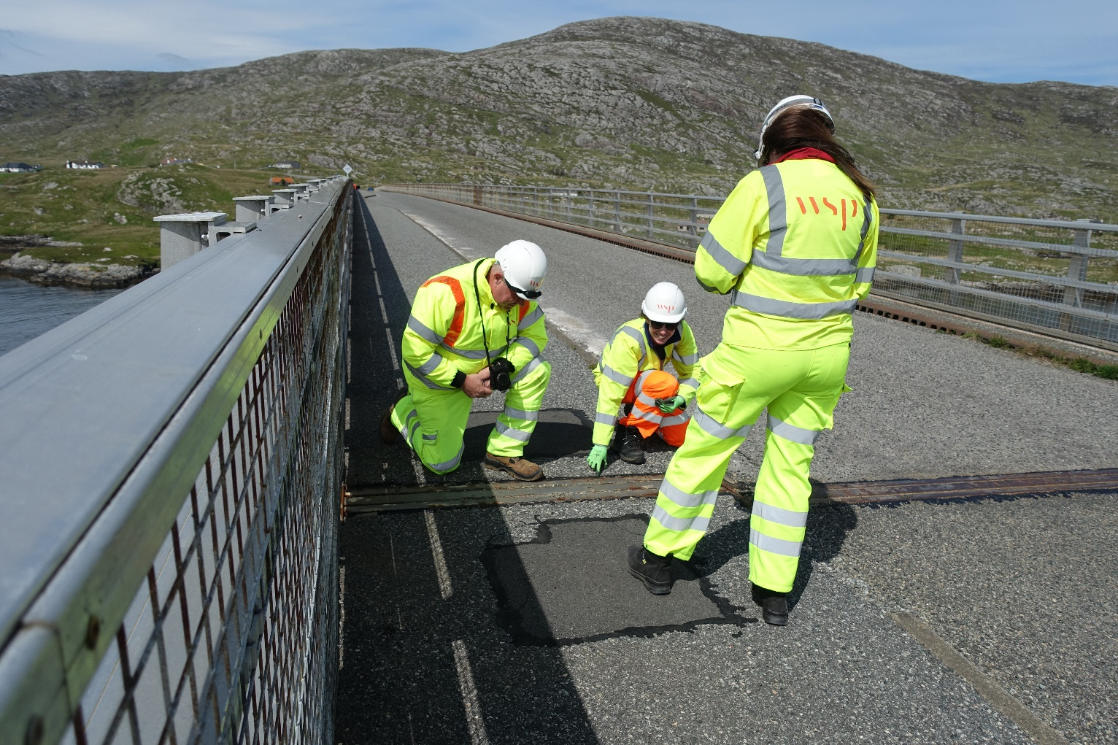
Types of work we are undertaking
Bridge Inspections
PTSI Reviews
Bridge Structural Assessments
Bridge Optioneering
Bridge Design
Bridge Maintenance / Refurbishment
Asset Management Systems and Reviews
Road Improvements
Speed Limit Reviews
Road Safety Plans
Active Travel Route Optioneering / Design
Core Path Surveys
Bus Corridor Appraisals
Parking Studies
Development Control Support
Transportation Modelling
EV Strategy & Business Cases

Slide 6
Steve Byer - Highways
Joanne Somerville - Bridges

